Slide 1

Vector Database Management Systems: Fundamental Concepts, Use-Cases, and Current Challenges

Slide 2
Areeba Khan
Presentation By
Shaheer Ali
301-221044
BS CS 5th Section-A
Department of Computer Science
Hazara University
301-221012
BS CS 5th Section-A
Department of Computer Science
Hazara University

Slide 3

Vector Database Management Systems: Fundamental Concepts and Use-Cases
Title
Author:

Slide 4
Introduction
What are Vector Database Management Systems (VDBMSs)?
VDBMSs are specialized systems designed to store and process high-dimensional numerical vectors.
They are widely used in applications like recommendation systems, similarity search, and chatbots.
Why are VDBMSs important?
They address the growing need to handle high-dimensional data efficiently.
VDBMSs enable faster and more accurate vector similarity searches and operations.
They are essential tools for modern AI applications, such as reverse image search and natural language processing.

Slide 5
Overview of Current Products and Features
Major VDBMSs offer diverse integrations and unique querying capabilities for various applications.

Slide 6
Comparison of VDBMS Features
Existing VDBMSs
Key players include Pinecone, Milvus, and Deep Lake
Pinecone, Milvus, and Deep Lake enable efficient similarity search, large-scale vector management, and dataset storage with versioning for AI workflows.
Different VDBMSs support unique integrations like OpenAI and LangChain.
They serve use cases such as image retrieval, chatbot development, and voice recognition.

Slide 7
Comparison of VDBMS Features
Different VDBMSs support unique integrations like OpenAI and LangChain.
Feature | Pinecone | Milvus | Deep Lake
Vector Similarity Search | Yes | Yes | Yes
Metadata Handling | Advanced | Advanced | Basic
Multi-GPU Support | Yes | Yes | Yes
Primary Use Case | Chatbots | Search | ML Workflow
Integrations | OpenAI | LangChain | Pytorch

Slide 8
Fundamental Concepts of VDBMS
Vectors are numerical data representations, varying from low to high-dimensional, depending on task complexity.

Slide 9
Vectors as Data Representations
Vectors are numerical representations of data features.
Low-dimensional vectors are used for simpler tasks like geospatial queries.
High-dimensional vectors capture complex data characteristics like image textures
Characteristics of VDBMS
VDBMSs focus on managing high-dimensional vector data.
They offer vector similarity search, indexing, and operations not commonly found in traditional databases.

Slide 10
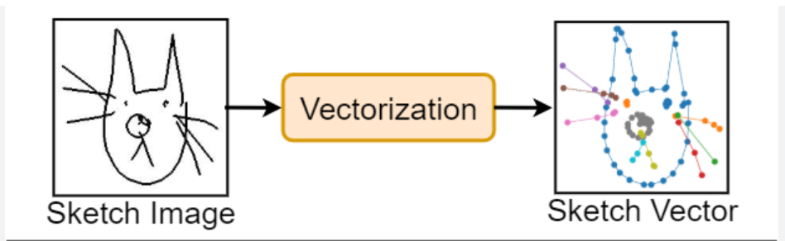
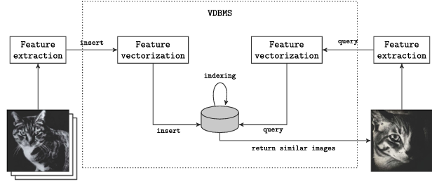
Database System Architecture
Vectorization, storage, and query execution are key components for managing and retrieving vector data efficiently.
Vectorization: Converting raw data into vector embeddings.
Storage: Managing vectors, metadata, and original data.
Query Execution: Optimizing queries for vector similarity and metadata filters.

Slide 11
Applications of VDBMS
VDBMSs excel in similarity search, image/video recognition, voice data processing, and chatbot long-term memory.

Slide 12
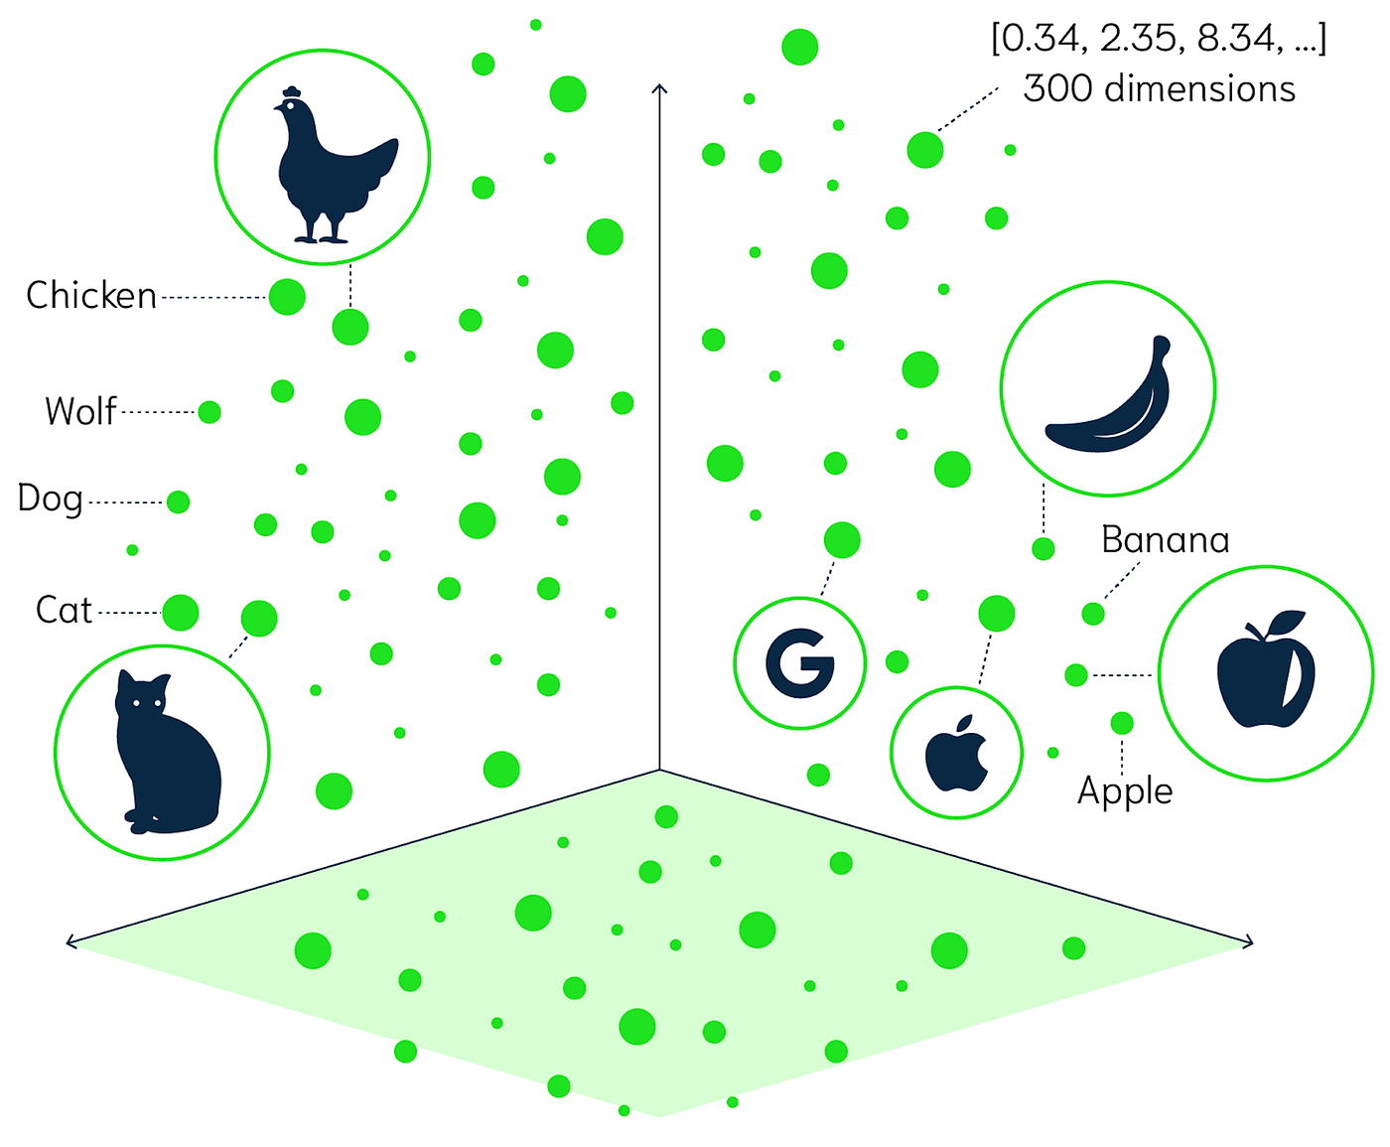
General Similarity Search
VDBMSs efficiently search for approximate similarities in large datasets.
They are useful in domains like healthcare, finance, and e-commerce.
Enable fast retrieval of similar data points, reducing computational costs.
Enhance applications like recommendation systems and content retrieval.

Slide 13
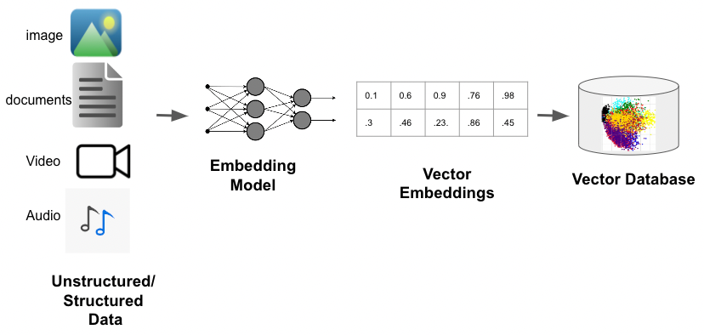
Image and Video Similarity
Images and videos are transformed into vector embeddings.
Used for tasks like image recognition, object detection, and video retrieval.
Improve reverse image search and content-based video analysis.
Support applications like security surveillance and media platforms.

Slide 14

Voice Recognition
Voice data is converted into feature vectors for analysis.
Used in speech-to-text applications and speaker recognition.
Essential for tasks like user authentication and conversational AI systems.
Enhance virtual assistants and voice-controlled applications.

Slide 15
Chatbots and Long-Term Memory
VDBMSs store user interactions for long-term context retention.
Help chatbots improve personalized responses and conversations.
Enable better understanding of user queries over time.
Boost user engagement and satisfaction in chatbot applications.

Slide 16
Conclusion
VDBMSs hold significant potential, driven by ongoing advancements and community support.

Slide 17
Conclusion
VDBMSs efficiently manage high-dimensional vector data.
They are essential for applications like recommendation systems, similarity search, and chatbots.
VDBMSs focus on vector similarity search and indexing.
Key VDBMS products: Pinecone, Milvus, Deep Lake.
Use cases include image retrieval, voice recognition, and chatbots.
Challenges: speed vs. accuracy, dimensionality, and system maturity.
Continued advancements are needed for scalability and stability.
VDBMSs will play a key role in managing unstructured data.

Slide 18
Questions & answers
Now its your turn , make questions we will try to answer the best.

Slide 19
Allah Hafiz
Credits:
Shaheer Ali & Areeba Khan
We would like to express our gratitude to everyone who contributed to this research and presentation.
Special thanks to Mam Muneeba, for her support and guidance.
Thank you for your attention.

